Slide 1
Video Summarization Team 11

Slide 2
01
02
03
Introduction
Assumptions
Algorithms
04
05
Examples
Conclusion
Here we take a look at what we aim to achieve
Here we can see assumption we used in out work
We Can Take A look at our Algorithm Choices
A Video Summarized by All Our Chosen Algorithms
We have a look at what we achieved and concluded

Slide 3
INTRODUCTION
Our Approach

Slide 4
Introduction
Our work focuses on the summarization of videos using extractive summarization methods by first transcribing them then applying a user chosen Natural Language Processing algorithm to get the final summary which can be chosen using our application.

Slide 5
Assumptions
Prerequisites and assumptions

Slide 6
Our Assumptions
Summarization Method
There are two main types of summarization: Abstractive and Extractive. Here our aim is to generate a summary from already provided keywords, so extractive summarization is used.
Language Used
Videos are in the English Language. Algorithms are unfazed by accents.

Slide 7
Algorithms
Our Chosen Algorithms

Slide 8
Algorithms
Pure NLTK
Gensim
Luhn
LexRank
KL-Sum
Naïve Reduction
Algorithm using only nltk library’s tokenizers
Algorithm using gensim library’s TextRank based Algo
Algorithm using sumy library’s Luhn Heuristic Algo
Algorithm using sumy library’s LexRank based Algo
Algorithm using sumy library’s KL-Sum based Algo
Algorithm using sumy library’s Normal Reduction Algo

Slide 9
Let’s Dive in
Brief description of all our implemented Video Summarization Algorithms

Slide 10
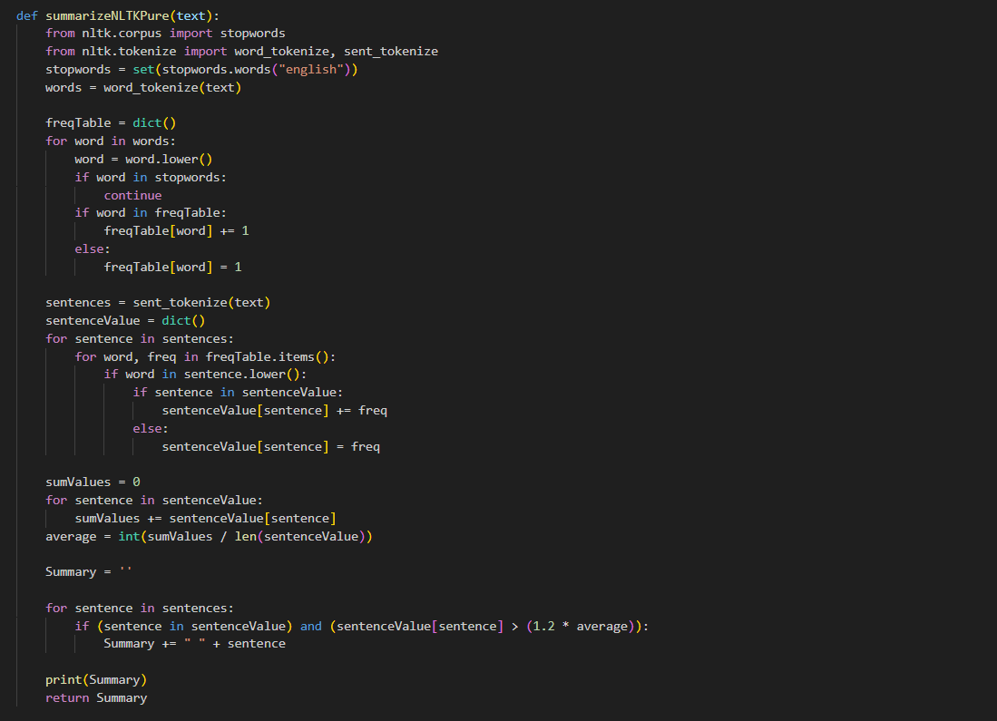
Pure NLTK Algorithm
The Algorithm employs a straightforward approach by assigning importance scores to sentences based on the frequency of non-stop words.

Slide 11
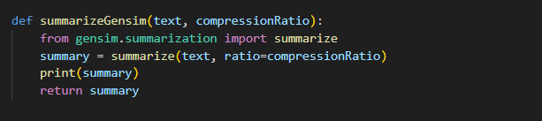
Gensim Algorithm
Summarization is done by representing words or sentences as points on a graph connected by relationships. Each point gets an initial score, and through a process of refining and ranking based on connections, the algorithm identifies the most important words or sentences

Slide 12
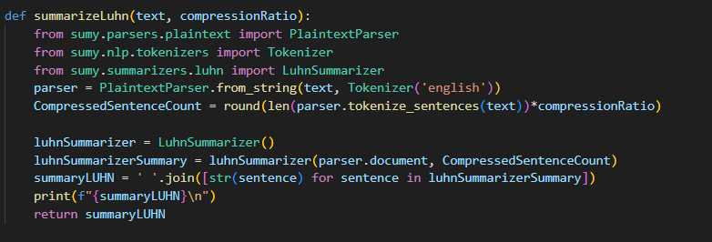
Luhn Heuristic Algorithm
Summarization is done by giving importance to words that appear frequently. It uses a method called TF-IDF to weigh words and scores sentences based on concentration of important words. The scoring considers the number of important words in a sentence and their placement.

Slide 13
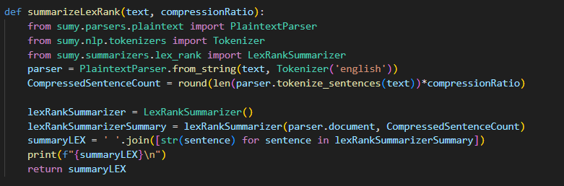
LexRank Algorithm
Summarization is done by measuring sentence importance based on how similar they are to others. and calculating scores using a method called power iteration.

Slide 14
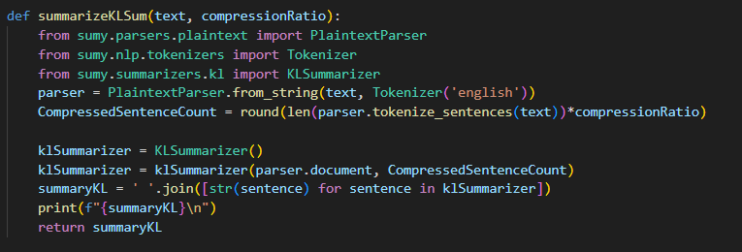
KL-Sum Algorithm
Summarization is done by trying to preserve the original document's word distribution. It uses KL Divergence to measure differences between distribution in summary and original and only chooses sentences that minimizes the difference

Slide 15
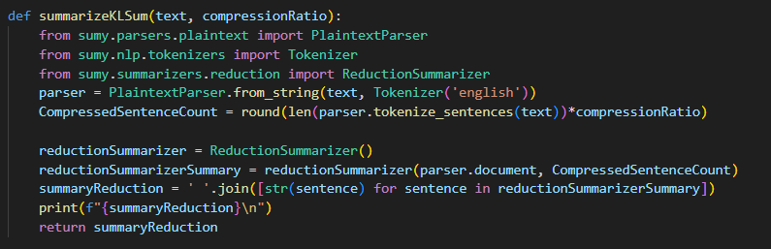
Naïve Reduction Algorithm
Summarization is done by rating sentences based on similarity between it and other sentence by counting common words, it then converts rating to weight and finally, selecting sentences with the highest to add to summary.

Slide 16
Examples
A video that has been summarized using all of the different summarization methods

Slide 17


Original Video

Slide 18


Pure NLTK

Slide 19

Gensim

Slide 20

Luhn Heuristic

Slide 21

LexRank

Slide 22

KL-Sum

Slide 23
Naïve Reduction

Slide 24
Conclusion
What we achieved

Slide 25
Our Conclusion
We focused on crafting an extractive summarization app, leveraging a curated selection of algorithms that includes NLTK, Gensim TextRank, Luhn's Heuristic, LexRank, KL-Sum, and Naïve Reduction. This approach prioritizes fidelity to the source material.
Python served as the backbone, accompanied by Gensim, Sumy, json, pyqt5, nltk, whisper, pydub, and moviepy all encapsulated in a meticulously crafted GUI using pyqt5 that fosters simplicity and user engagement.
In conclusion, our work contributes to the ongoing evolution of video summarization.

Slide 26
Thanks
Do you have any questions?

